Slide 1
Decision Engines for Software Analysis using SMT Solvers - Using Z3, - An example using Scheduling - Core and User Theories PLDI 2010 - Toronto
Leonardo de Moura and Nikolaj Bjørner
Microsoft Research

Slide 2






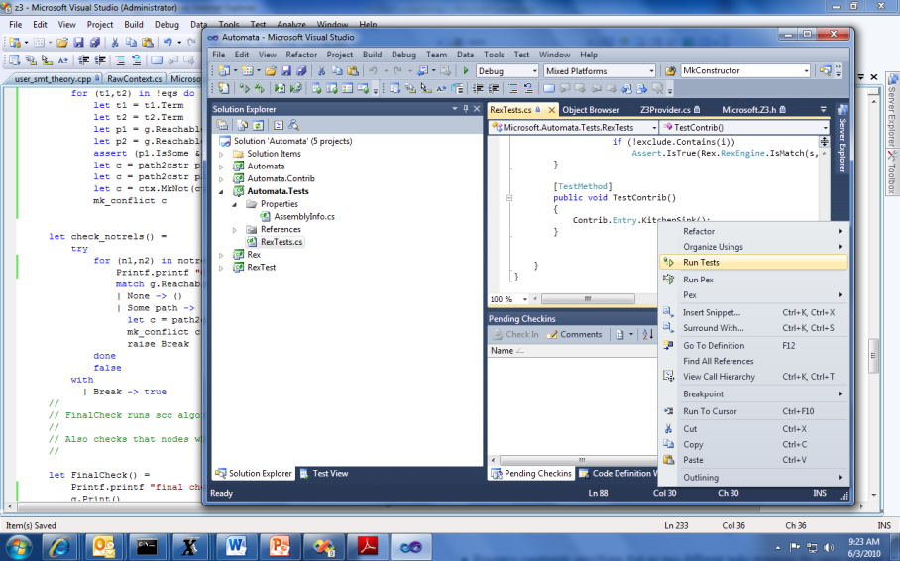


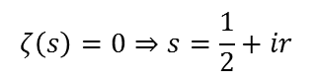
Job Shop Scheduling
Machines
Tasks
Jobs
P = NP?
Laundry
$$ζ\left(s\right)=0⇒s=\frac{1}{2}+ir$$

Slide 3
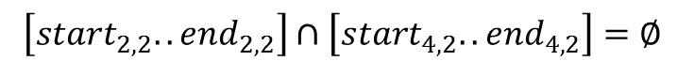
Job Shop Scheduling
Constraints:
Precedence: between two tasks of the same job
Resource: Machines execute at most one job at a time
3
1
2
4
$$\left[start_{2,2}..end_{2,2}\right]∩\left[start_{4,2}..end_{4,2}\right]=∅$$

Slide 4
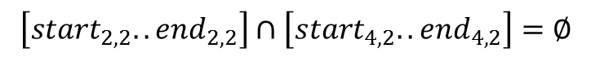
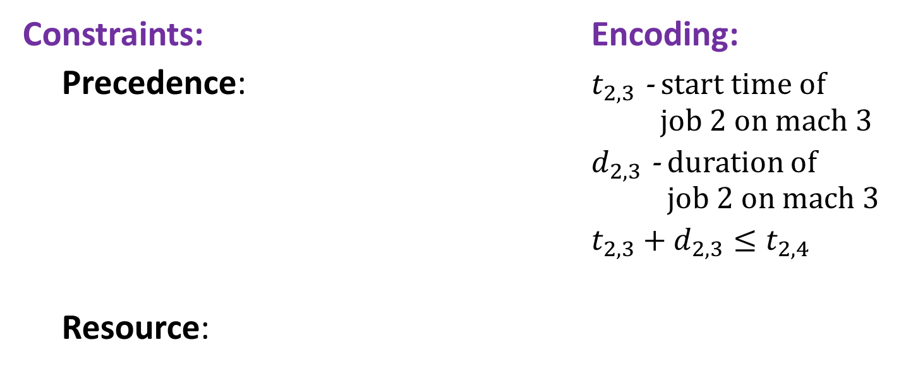
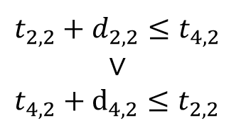
Job Shop Scheduling
Constraints: Encoding:
Precedence: $t_{2,3}$ - start time of job 2 on mach 3
$d_{2,3}$ - duration of job 2 on mach 3
$t_{2,3}+d_{2,3}≤t_{2,4}$
Resource:
3
1
4
2
Not convex
$$t_{2,2}+d_{2,2}≤t_{4,2}$$
$$∨$$
$$t_{4,2}+d_{4,2}≤t_{2,2}$$
$$\left[start_{2,2}..end_{2,2}\right]∩\left[start_{4,2}..end_{4,2}\right]=∅$$

Slide 5
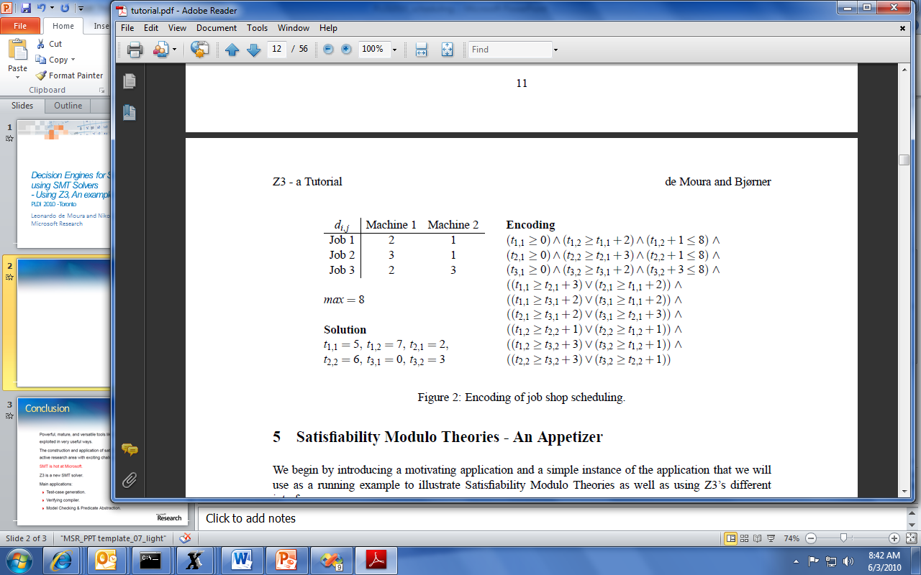
Job Shop Scheduling

Slide 6
Job Shop in SMT2
SMT2 is a new format for exchanging benchmarks between SMT solvers.
It is convenient for text-based interaction.
Z3 currently supports most of SMT2 + includes additional goodies

Slide 7
Job Shop in SMT2
Start Z3 using smt command-mode in interactive (/si) enable models (/m).
Z3.exe /smtc /si /m
Optionally specify the logic. The benchmark is going to use Integer Difference Logic and use the a solver for difference logic
(set-logic QF_IDL)
(declare-fun t11 () Int)
(declare-fun t12 () Int)
(declare-fun t21 () Int)
(declare-fun t22 () Int)
(declare-fun t31 () Int)
(declare-fun t32 () Int)
Declare constants that are going to be used in the problem.
Constants are functions that don’t take any arguments.

Slide 8
Job Shop in SMT2
Add the precedence constraints
(assert (and (>= t11 0) (>= t12 (+ t11 2)) (<= (+ t12 1) 8)))
(assert (and (>= t21 0) (>= t22 (+ t21 3)) (<= (+ t22 1) 8)))
(assert (and (>= t31 0) (>= t32 (+ t31 2)) (<= (+ t32 3) 8)))

Slide 9
Job Shop in SMT2
Add the resource constraints
(assert (or (>= t11 (+ t21 3)) (>= t21 (+ t11 2))))
(assert (or (>= t11 (+ t31 2)) (>= t31 (+ t11 2))))
(assert (or (>= t21 (+ t31 2)) (>= t31 (+ t21 3))))
(assert (or (>= t12 (+ t22 1)) (>= t22 (+ t12 1))))
(assert (or (>= t12 (+ t32 3)) (>= t32 (+ t12 1))))
(assert (or (>= t22 (+ t32 3)) (>= t32 (+ t22 1))))

Slide 10
Job Shop in SMT2
(check-sat)
(model)
Check satisfiability of the assertions
Display the model
("model" "t11 -> 5
t12 -> 7
t21 -> 2
t22 -> 5
t31 -> 0
t32 -> 2")

Slide 11
SMT2 Brief Sketch
(declare-fun id (sort*) sort) declare function
(define-fun id ((id sort)*) sort term)
define an expression shorthand
(assert term) assert formula
(check-sat) check satisfiability of assertions
(push [number]) push 1 (or number) scopes
(pop [number]) pop 1 (or number) scopes
(get-info model) model from satisfied assertions

Slide 12
SMT2 Brief Sketch
term ::= id
| number
| (id term+)
| (forall (id sort)+ term)
sort ::= id | (id sort+)
id ::= and | or | => | + | - | * | …| token | …

Slide 13
Job Shop in Z3’s C API
C
SMT2
.NET
Ocaml
Python
Z3 native format
Z3 exposes a set of APIs over C.
It is the basis of other wrappers
http://www4.in.tum.de/ ~boehmes/ z3-python.html
Z3

Slide 14
Job Shop in Z3’s C API
#include "z3.h“
Include Z3 definitions
int main() {
Z3_config cfg = Z3_mk_config();
Z3_set_param_value(cfg, "MODEL", "true");
Z3_context ctx = Z3_mk_context(cfg);
// Declare and assert ….
Z3_model m = 0;
Z3_bool r = Z3_check_and_get_model(ctx, &m);
if (m) {
printf("%s\n", Z3_model_to_string(ctx, m));
Z3_del_model(ctx, m);
}
Z3_del_context(ctx);
Z3_del_config(cfg);
}
Create a configuration
Set configuration
Create a logical context
Check for satisfiability
Print the model
Release resources

Slide 15
Job Shop in Z3’s C API
Z3_ast t11 = mk_var(ctx, "t11");
Z3_ast t12 = mk_var(ctx, "t12");
Z3_ast t21 = mk_var(ctx, "t21");
…
Z3_ast mk_var(Z3_context ctx, Z3_string name) {
Z3_symbol s = Z3_mk_string_symbol(ctx, name);
return Z3_mk_const(ctx, s, Z3_mk_int_sort(ctx));
}
Create variables
(constants)

Slide 16
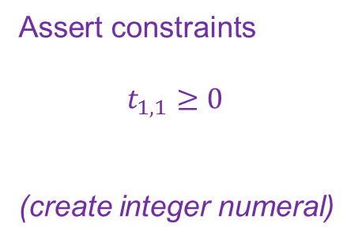
Job Shop in Z3’s C API
Z3_assert_cnstr( ctx, Z3_mk_ge(
ctx,
t11,
Z3_mk_int(ctx, 0, Z3_mk_int_sort(ctx))))
Assert constraints
$$t_{1,1}≥0$$
(create integer numeral)

Slide 17
Job Shop from .NET
using namespace Microsoft.Z3;
void encode() {
using(Config cfg = new Config()) {
cfg.SetParamValue("MODEL","true");
using(Context ctx = new Context(cfg)) {
// Declare and assert
Model m = null;
LBool r = ctx.CheckAndGetModel(out m);
if (m != null) {
m.Display(System.Console.Out);
m.Dispose();
}
}}}
Open Z3 namespace
Create a configuration
Create a logical context
Check for satisfiability
Print the model
Dispose resources

Slide 18
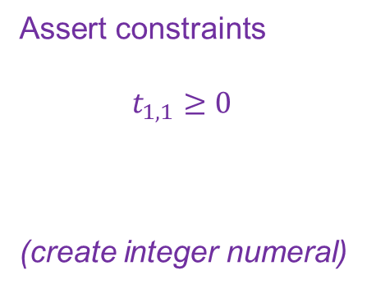
Job Shop from .NET
ctx.AssertCnstr( V("t11") >= I(0));
Term I(int a) { return ctx.MkIntNumeral(a); }
Term V(string name) { return ctx.MkConst(name, ctx.MkIntSort()); }
Assert constraints
$$t_{1,1}≥0$$
(create integer numeral)

Slide 19
Job Shop from F# (quotations)
Create Quoted
Expression
open Microsoft.Z3
open Microsoft.Z3.Quotations
do Solver.prove <@ Logic.declare
(fun t11 t12 t21 t22 t31 t32 ->
not
((t11 >= 0I) && (t12 >= t11 + 2I) && (t12 + 1I <= 8I) &&
(t21 >= 0I) && (t22 >= t21 + 3I) && (t32 + 1I <= 8I) &&
(t31 >= 0I) && (t32 >= t31 + 2I) && (t32 + 3I <= 8I) &&
(t11 >= t21 + 3I || t21 >= t11 + 2I) &&
(t11 >= t31 + 2I || t31 >= t11 + 2I) &&
(t21 >= t31 + 2I || t31 >= t21 + 3I) &&
(t12 >= t22 + 1I || t22 >= t12 + 1I) &&
(t12 >= t32 + 3I || t32 >= t12 + 1I) &&
(t22 >= t32 + 3I || t32 >= t22 + 1I)
)
)
@>

Slide 20
Summary
There are many ways to have fun with Z3
Text:
SMT, SMT2, Simplify, Native low-level Z3 format.
Programmatic:
C
.Net, F# quotations
Ocaml
Python http://www4.in.tum.de/~boehmes/z3-python.html
From Advanced Tools:
Pex, SpecExplorer, FORMULA

Slide 21
Inside Z3
Theories
Functions, Arithmetic, Arrays, Bit-vectors, Data-types
User-defined theories
Answers
Models, proofs, Simplification, Implied equalities

Slide 22
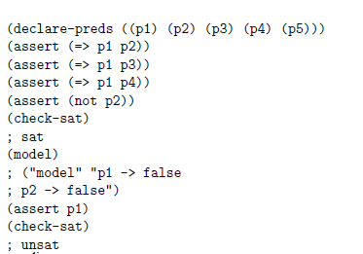
Theories – propositional logic

Slide 23
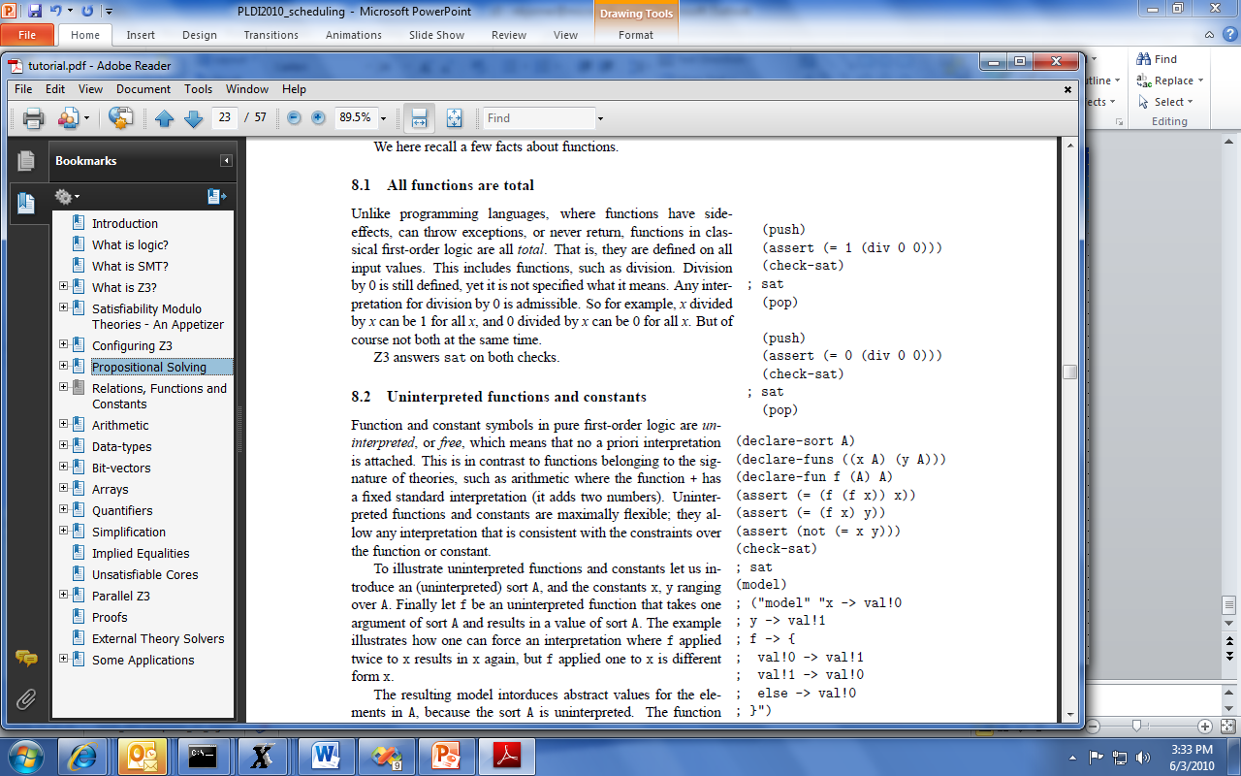
Theories – Relations, Functions, Constants
All functions are total
Recursive functions
No least fixed-points: Recursive functions as equations admits more solutions
Un-interpreted functions and constants

Slide 24
Theories - Arithmetic
Linear arithmetic Solver using
Simplex, Branch/bound, Gomory cuts
Example integer linear arithmetic formula (<= (+ y (mod x 4) (div y 3)) (* 4 z))
Non-linear arithmetic simplification using
Groebner basis computation
(assert (= (* x x) (+ x 2)))
(assert (= (* x y) x))
(assert (= (* (- y 1) z) 1))
(check-sat)
; unsat
x must be non 0
If x is non-zero, then y = 1
y cannot be 1

Slide 25
Theories – Bit-vectors
(concat v1 v2)
(bvand v1 v2)
(bvadd v1 v2)
(bvextract[4:2] v)
1
0
1
0
1
1
⊗
0
1
1
0
0
1
=
1
0
1
0
1
1
0
1
1
0
0
1
1
0
1
0
1
1
=
∧
0
0
1
0
0
1
0
1
1
0
0
1
1
0
1
0
1
1
=
+
0
0
0
1
0
0
0
1
1
0
0
1
1
0
1
0
1
1
[4:2] =
0
1
0

Slide 26
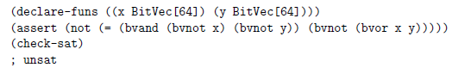
Theories – Bit-vectors
Example, de Morgan a la x64

Slide 27
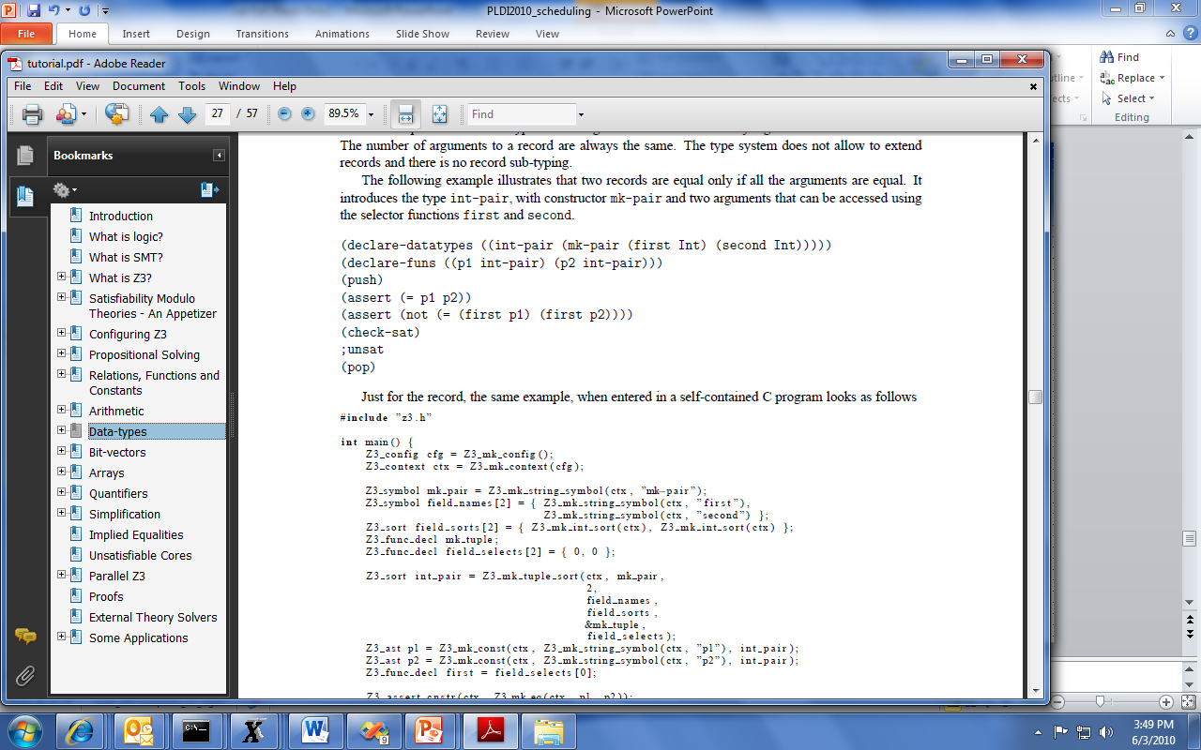
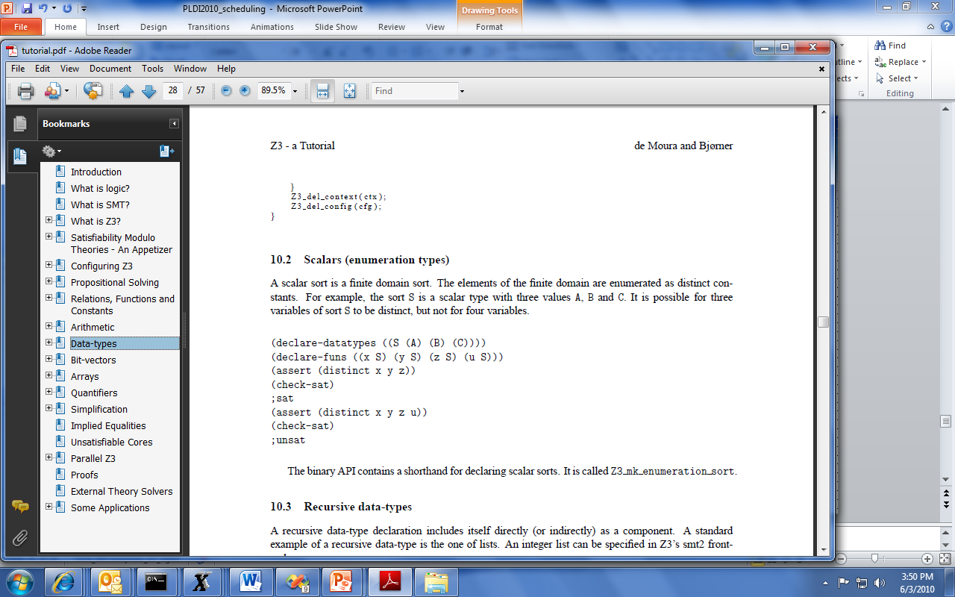

Theories – Data-types
Records
Scalars
Recursive

Slide 28
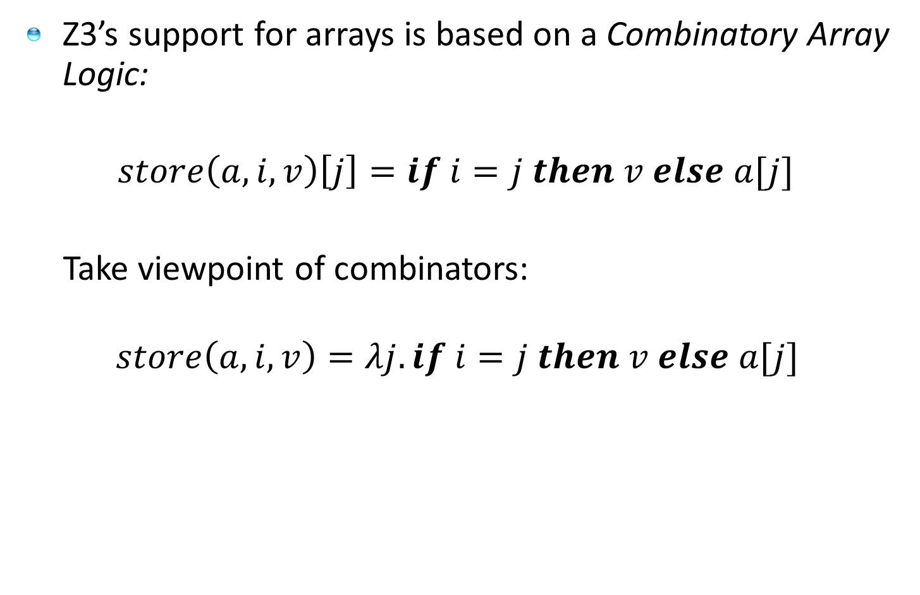
Theories – Arrays
Z3’s support for arrays is based on a Combinatory Array Logic:
$store\left(a,i,v\right)\left[j\right]=if i=j then v else a[j]$
Take viewpoint of combinators:
$$store\left(a,i,v\right)=λj. if i=j then v else a[j]$$

Slide 29
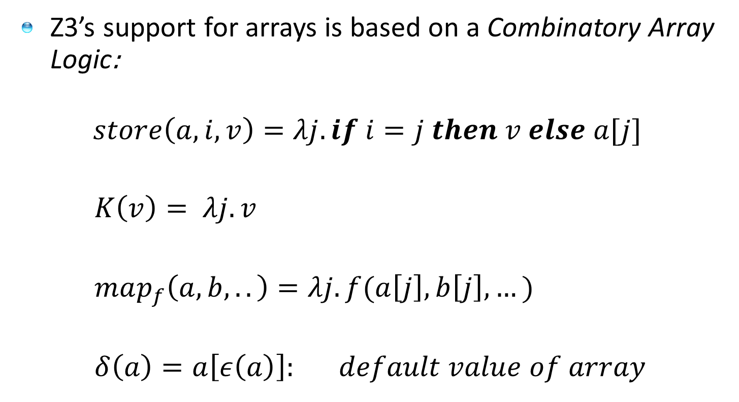
Theories – Arrays
Z3’s support for arrays is based on a Combinatory Array Logic:
$$store\left(a,i,v\right)=λj. if i=j then v else a[j]$$
$K\left(v\right)= λj. v$
$map_{f}\left(a,b,..\right)=λj. f(a\left[j\right],b\left[j\right],…)$
$δ\left(a\right)=a\left[ε\left(a\right)\right]: default value of array$

Slide 30
Theories – Arrays
Z3’s support for arrays is based on a Combinatory Array Logic:
Allows encoding some idioms, such as sets and bags

Slide 31
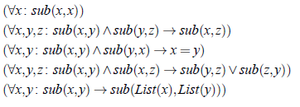
Quantifiers
Example: Single inheritance subtyping
(declare-sort Type)
(declare-fun subtype (Type Type) Bool)
(delcare-fun List (Type) Type)
(assert (forall (x Type) (subtype x x)))
(assert (forall (x Type) (y Type) (z type)
(=> (and (subtype x y) (subtype y z))
(subtype x z))))
(assert (forall (x Type) (y Type)
(=> (and (subtype x y) (subtype y x))
(= x y))))
(assert (forall (x Type) (y Type) (z type)
(=> (and (subtype x y) (subtype x z))
(or (subtype y z) (subtype z y)))))
(assert (forall (x Type) (y Type)
(=> (subtype x y)
(subtype (List x) (List y)))))

Slide 32
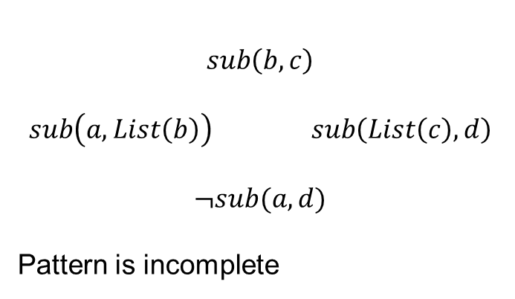
Quantifiers
Example: Single inheritance subtyping
(assert (forall (x Type) (y Type)
(=> (subtype x y)
(subtype (List x) (List y)))
:pat {(subtype (List x) (List y)) }
)
)
$$sub\left(b,c\right)$$
$$sub\left(a,List\left(b\right)\right) sub\left(List\left(c\right),d\right)$$
$$¬sub(a,d)$$
Pattern is incomplete

Slide 33
Quantifiers
Example: Single inheritance subtyping
(assert (forall (x Type) (y Type)
(=> (subtype x y)
(subtype (List x) (List y)))
:pat {(subtype x y) }
)
)
(=> (subtype a b) (subtype (List a) (List b)))
(=> (subtype (List a) (List b)) (subtype (List (List a)) (List (List b))) )
… matching loop

Slide 34
Quantifiers
Example: Single inheritance subtyping
(assert (forall (x Type) (y Type)
(=> (subtype x y)
(subtype (List x) (List y)))
:pat {(List x) (List y) }
)
)
Multi-pattern
☺ Terminates:
depth of new terms is bounded
☹ Expensive:
Quadratic
Instantiated for every pair of (List a) and (List b) created during search
.. But transitive closure is worse – it is cubic.

Slide 35
Quantifiers
Example: Single inheritance subtyping
(assert (forall (x Type) (y Type) (z Type) (u Type)
(=> (subtype x y)
(subtype (List x) (List y)))
:pat {(subtype (List x) z)
(subtype u (List y)) }
)
)
Yes you can also hack with patterns

Slide 36
User-theories
You can implement your own theory solver on top of Z3.
A PLDI tutorial exclusive new feature
Example
A solver for the theory of Partial Orders

Slide 37
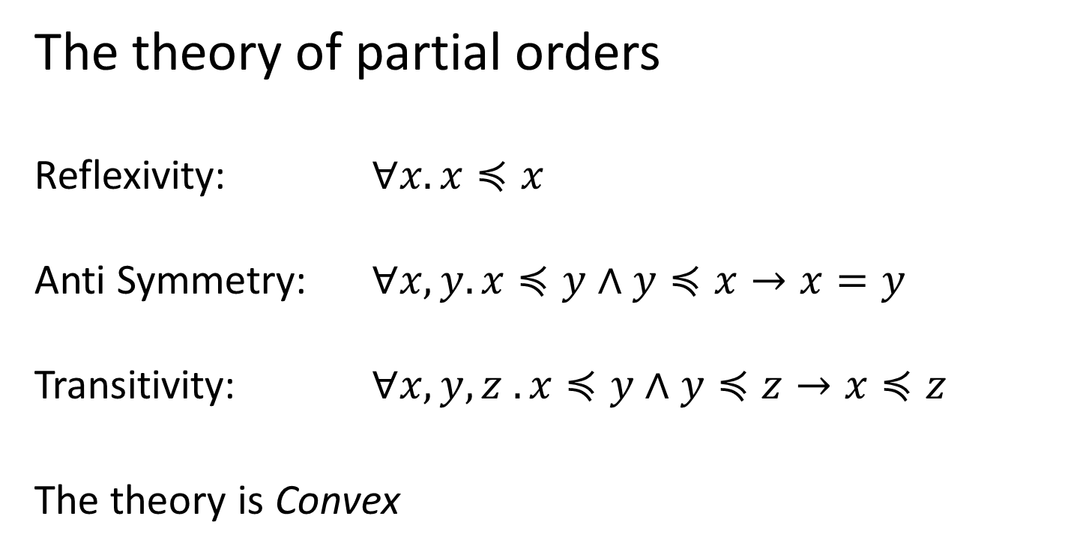
User-theories: Partial Orders
The theory of partial orders
Reflexivity: $∀x. x≼x$
Anti Symmetry: $∀x,y. x≼y∧y≼x→x=y$
Transitivity: $∀x, y, z . x≼y∧y≼z→x≼z$
The theory is Convex

Slide 38


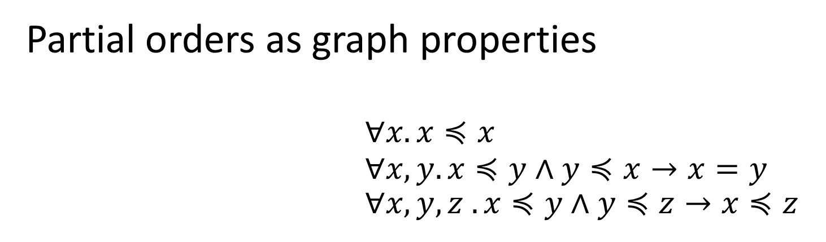



User-theories: Partial Orders
Partial orders as graph properties
$∀x. x≼x$ $∀x,y. x≼y∧y≼x→x=y$ $∀x, y, z . x≼y∧y≼z→x≼z$
$$≼$$
$$≼$$
$$≼$$
$$≼$$
$$≼$$

Slide 39

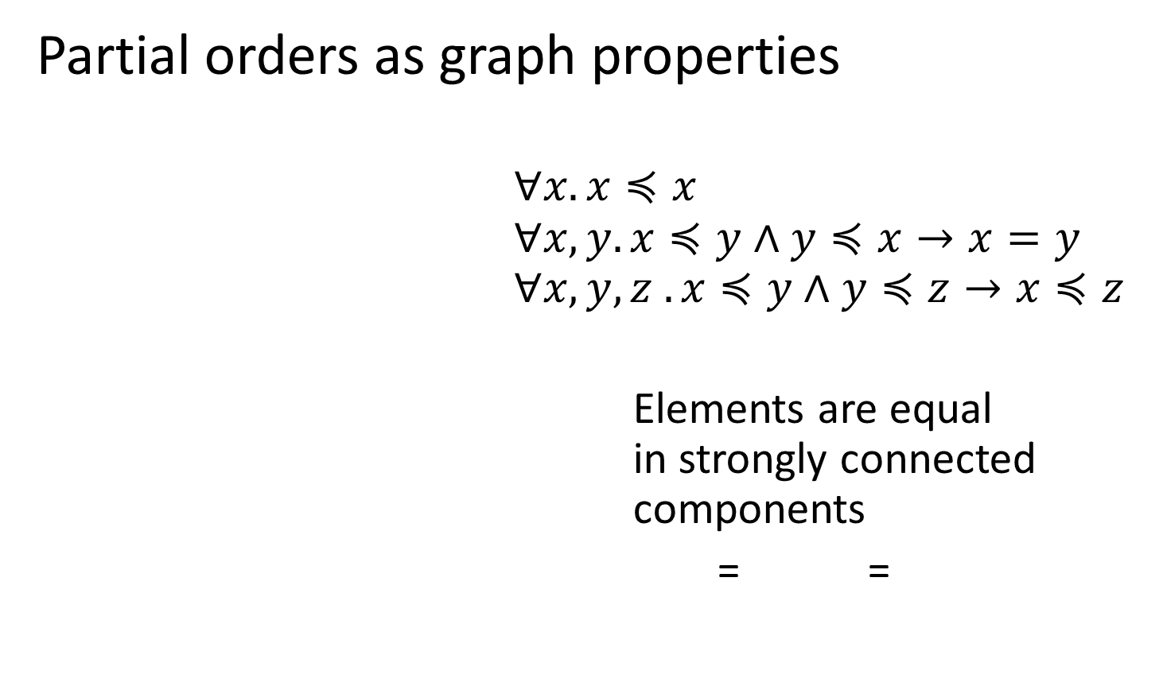
User-theories: Partial Orders
Partial orders as graph properties
$∀x. x≼x$ $∀x,y. x≼y∧y≼x→x=y$ $∀x, y, z . x≼y∧y≼z→x≼z$
Elements are equal in strongly connected components
= =
$$≼$$
$$≼$$
$$≼$$
$$≽$$
$$≼$$
$$≼$$

Slide 40



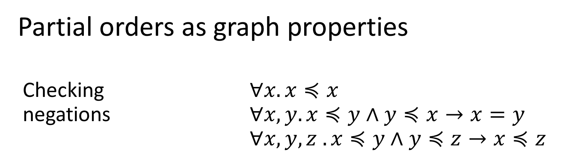




User-theories: Partial Orders
Partial orders as graph properties
Checking $∀x. x≼x$ negations $∀x,y. x≼y∧y≼x→x=y$ $∀x, y, z . x≼y∧y≼z→x≼z$
$$≼$$
$$≼$$
$$≼$$
$$≼$$
$$≼$$
$$≼$$
$$¬≼$$
$$¬≼$$
$$≼$$
$$≼$$
$$≼$$
$$≼$$
OK
Not OK

Slide 41





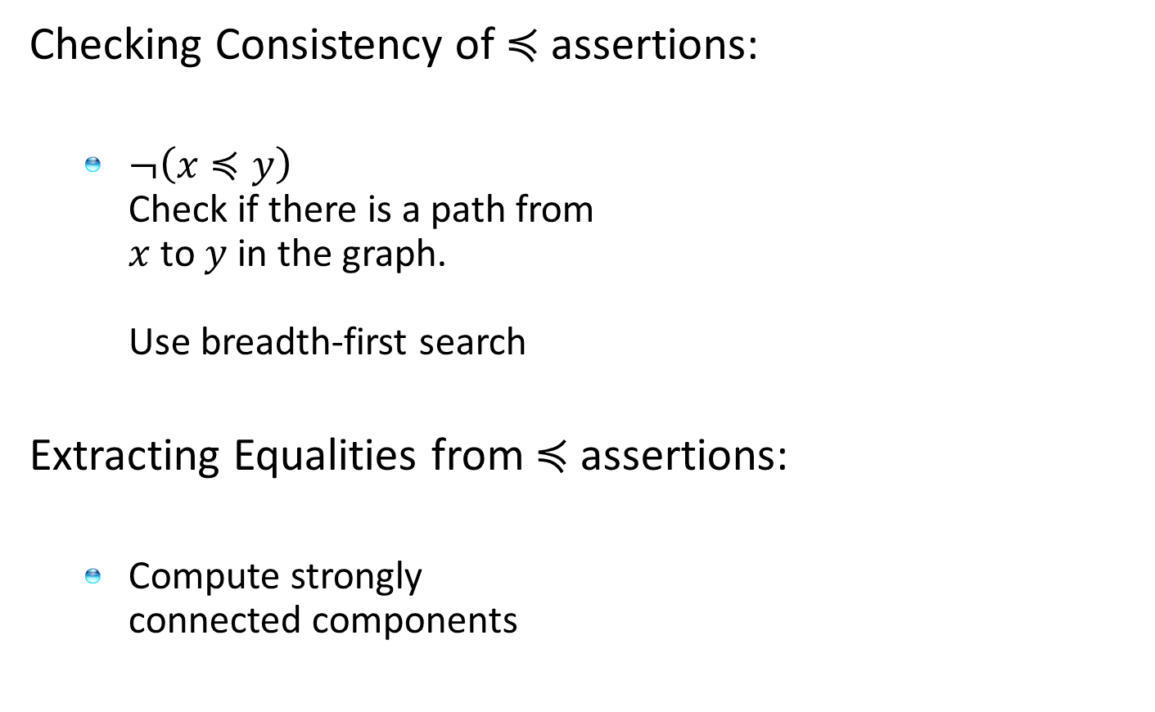







User-theories: Partial Orders
Checking Consistency of $≼$assertions:
$¬\left(x≼y\right)$ Check if there is a path from $x$ to $y$ in the graph. Use breadth-first search
Extracting Equalities from $≼$assertions:
Compute strongly connected components
$$≼$$
$$≼$$
$$≼$$
$$¬≼$$
$$≼$$
$$≼$$
$$≼$$
$$≼$$
$$≼$$
$$≽$$
$$≼$$
$$≼$$

Slide 42
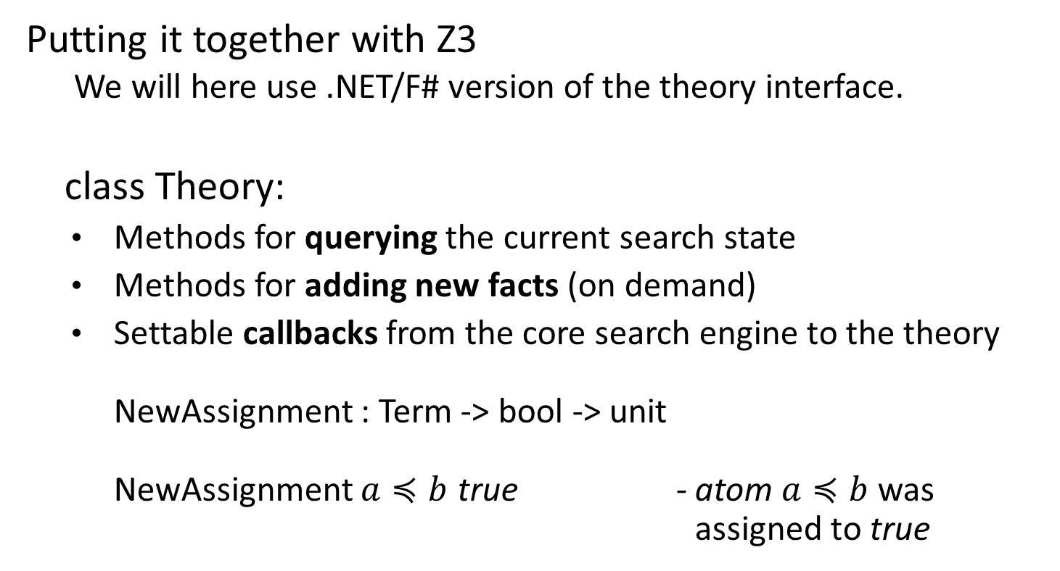
User-theories: Partial Orders
Putting it together with Z3 We will here use .NET/F# version of the theory interface.
class Theory:
Methods for querying the current search state
Methods for adding new facts (on demand)
Settable callbacks from the core search engine to the theory NewAssignment : Term -> bool -> unit NewAssignment $a≼b$ true - atom $a≼b$ was assigned to true

Slide 43
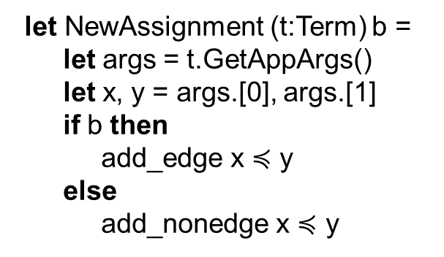
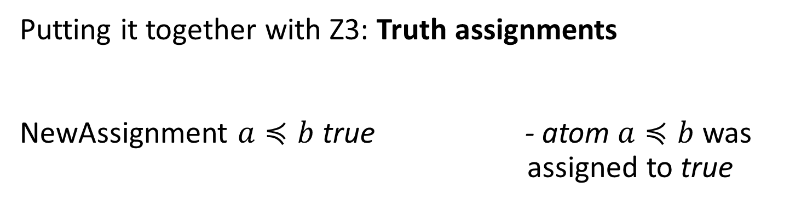
User-theories: Partial Orders
Putting it together with Z3: Truth assignments NewAssignment $a≼b$ true - atom $a≼b$ was assigned to true
let NewAssignment (t:Term) b =
let args = t.GetAppArgs()
let x, y = args.[0], args.[1]
if b then
add_edge x $≼$ y
else
add_nonedge x $≼$ y
let th = z3.MkTheory("po")
…
let initialize() =
th.NewAssignment <- NewAssignment

Slide 44
User-theories: Partial Orders
Putting it together with Z3: Saturation Checking for consistency
FinalCheck – When core solver is saturated, ask if user-solver is saturated too.
let FinalCheck () =
check_notrels()
add_implied_eqs()
true // solver did not give up
let add_implied_eqs() =
let eqs = ref []
graph.Sccs (add_eqs eqs)
for (t1,t2) in !eqs do
// find loop in graph // assert that loop implies equality of t1, t2
let th = z3.MkTheory("po")
…
let initialize() =
…
th.FinalCheck <- FinalCheck

Slide 45
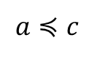
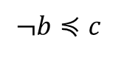
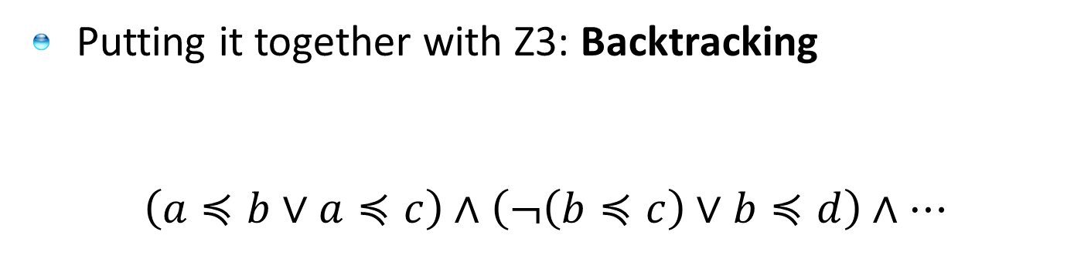
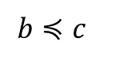
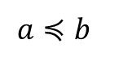
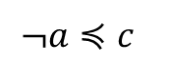
User-theories: Partial Orders
Putting it together with Z3: Backtracking
$\left(a≼b∨a≼c\right)∧\left(¬\left(b≼c\right)∨b≼d\right)∧…$
decide
Push() – on branching
Push()
Pop() – on backtracking
$$¬a≼c$$
$$a≼c$$
propagate
decide
$$a≼b$$
$$¬b≼c$$
$$b≼c$$

Slide 46
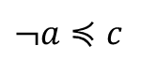
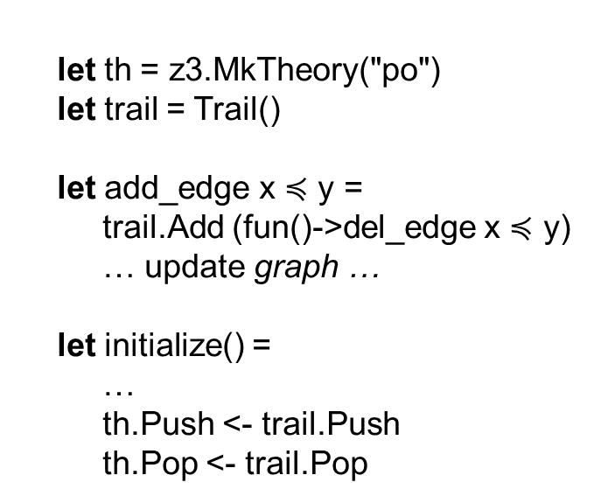
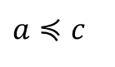
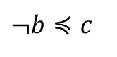
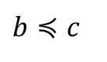
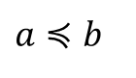
User-theories: Partial Orders
Putting it together with Z3: Backtracking
decide
Push()
Push()
Pop()
$$¬a≼c$$
$$a≼c$$
$$a≼b$$
propagate
decide
$$¬b≼c$$
$$b≼c$$
let th = z3.MkTheory("po") let trail = Trail()
let add_edge x $≼$ y = trail.Add (fun()->del_edge x $≼$ y) … update graph …
let initialize() =
…
th.Push <- trail.Push th.Pop <- trail.Pop
type Trail() =
let mutable t= [[]]
member this.Push() = t<- []::t
member this.Pop() =
for undo in head t do
undo()
t<- tail t
member this.Add undo = t<- (undo::head t)::(tail t)

Slide 47
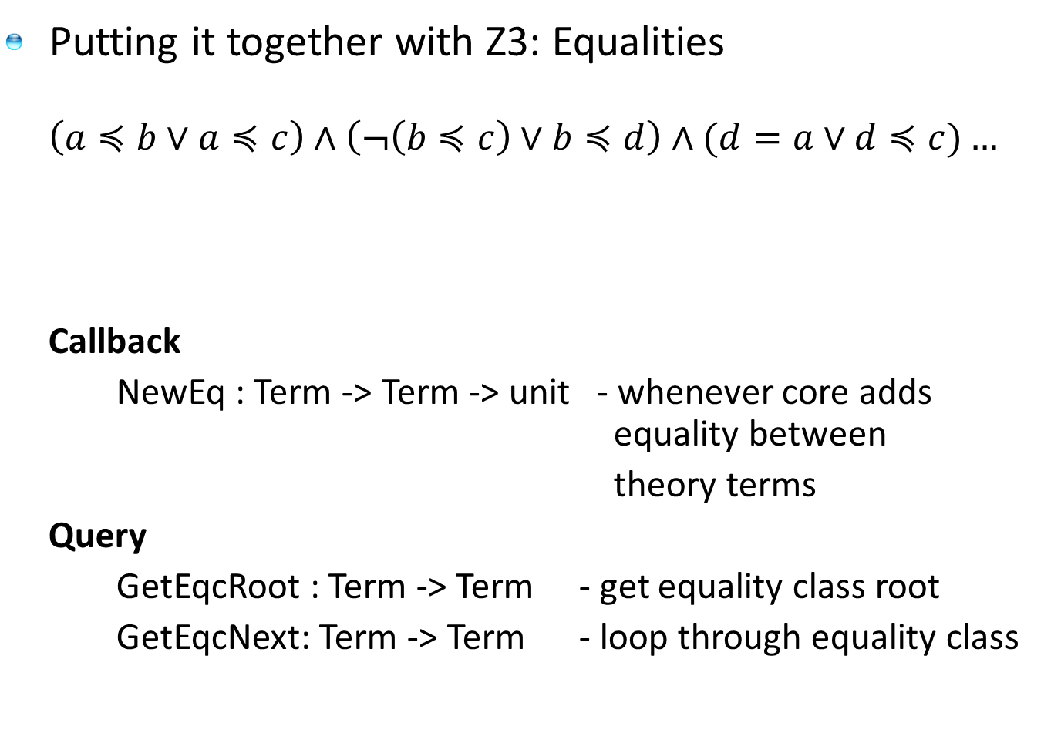
User-theories: Partial Orders
Putting it together with Z3: Equalities
$$\left(a≼b∨a≼c\right)∧\left(¬\left(b≼c\right)∨b≼d\right)∧(d=a∨d≼c)…$$
Callback
NewEq : Term -> Term -> unit - whenever core adds equality between
theory terms
Query
GetEqcRoot : Term -> Term - get equality class root
GetEqcNext: Term -> Term - loop through equality class
Equality added by Z3 during search

Slide 48
User-theories: Summary
Callbacks
Z3 core solver calls into solver during search NewEq : Term -> Term -> unit -new =
ReduceApp : FuncDecl -> Term[] -> Term option -simplify
Queries
Expose state during search GetEqcRoot : Term -> Term - = root GetParents: Term -> Term[] - super-terms
Updates
Let user solver update core solver state AssertTheoryAxiom: Term -> unit - assert during search

Slide 49
Getting Answers from Z3
Models
When a formula is satisfiable – an interpretation that satisfies the formula
Proofs
When a formula is unsatisfiable – a proof object with the proof steps used by Z3
Simplification
Use Z3 for algebraic simplification – heuristic, incomplete.
Implied Equalities
Obtain set of equalities implied by logical context

Slide 50
Summary
Core Theories
Z3 supports a set of core theories, Arithmetic, Data-Types, Bit-vectors, Arrays
Z3 supports formulas with quantifiers using instantiation
User Theories
Z3 supports adding user theories,
We sketched a basic solver for Partial Orders
Z3 is open for external solver integration: Strings, Queues, Formal Languages, Floating points, Orders, Lattices, Local Theories, Computer Algebra, ..
Answers
Z3 supports extracting additional information
Models, Proofs, Implied Equalities, Simplification

